Slide 1
Hashing

Slide 2
Static Hashing
A bucket is a unit of storage containing one or more records (a bucket is typically a disk block).
In a hash file organization we obtain the bucket of a record directly from its search-key value using a hash function.
Hash function h is a function from the set of all search-key values K to the set of all bucket addresses B.
Hash function is used to locate records for access, insertion as well as deletion.
Records with different search-key values may be mapped to the same bucket; thus entire bucket has to be searched sequentially to locate a record.

Slide 3
Example of Hash File Organization
Hash file organization of instructor file, using dept_name as key (See figure in next slide.)
There are 10 buckets,
The binary representation of the ith character is assumed to be the integer i.
The hash function returns the sum of the binary representations of the characters modulo 10
E.g. h(Music) = 1 h(History) = 2 h(Physics) = 3 h(Elec. Eng.) = 3

Slide 4
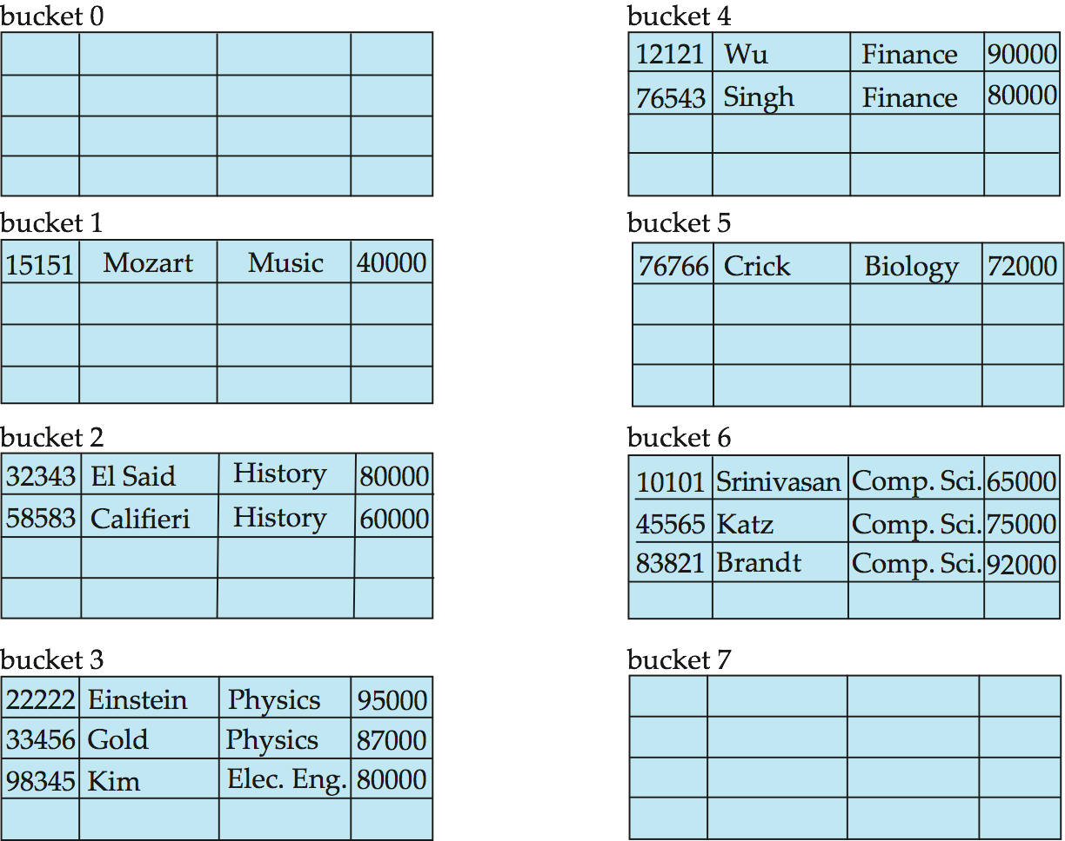
Example of Hash File Organization
Hash file organization of instructor file, using dept_name as key (see previous slide for details).

Slide 5
Hash Functions
Worst hash function maps all search-key values to the same bucket;
The access is time proportional to the number of search-key values in the file.
An ideal hash function is uniform, i.e., each bucket is assigned the same number of search-key values from the set of all possible values.
Ideal hash function is random, so each bucket will have the same number of records assigned to it irrespective of the actual distribution of search-key values in the file.
Typical hash functions perform computation on the internal binary representation of the search-key.
For example, for a string search-key, the binary representations of all the characters in the string could be added and the sum modulo the number of buckets could be returned.

Slide 6
Handling of Bucket Overflows
Bucket overflow can occur because of
Insufficient buckets
Skew in distribution of records. This can occur due to two reasons:
multiple records have same search-key value
chosen hash function produces non-uniform distribution of key values
Although the probability of bucket overflow can be reduced, it cannot be eliminated; it is handled by using overflow buckets.

Slide 7
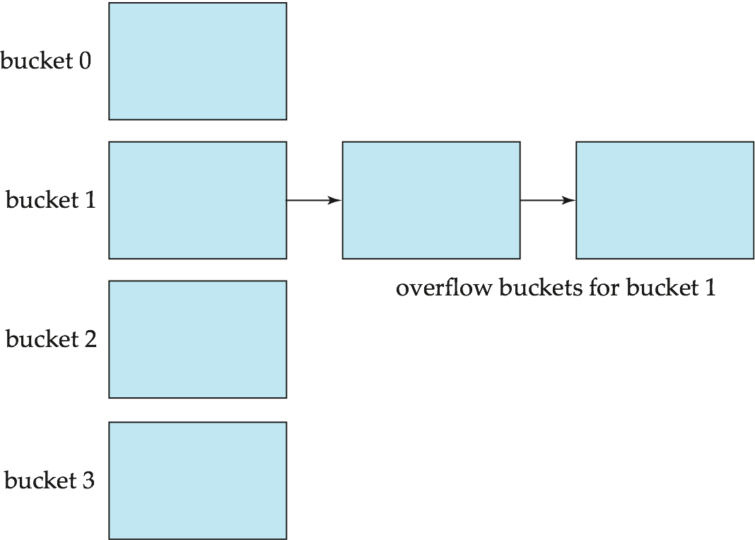
Handling of Bucket Overflows (Cont.)
Overflow chaining – the overflow buckets of a given bucket are chained together in a linked list.
Above scheme is called closed hashing.
An alternative, called open hashing, which does not use overflow buckets, is not suitable for database applications.

Slide 8
Collision Resolution
If, when an element is inserted, it hashes to the same value as an already inserted element, then we have a collision and need to resolve it.
There are several methods for dealing with this:
Separate chaining
Open addressing
Linear Probing
Quadratic Probing
Double Hashing

Slide 9
Separate Chaining
The idea is to keep a list of all elements that hash to the same value.
The array elements are pointers to the first nodes of the lists.
A new item is inserted to the front of the list.
Advantages:
Better space utilization for large items.
Simple collision handling: searching linked list.
Overflow: we can store more items than the hash table size.
Deletion is quick and easy: deletion from the linked list.

Slide 10
Example
Keys: 0, 1, 4, 9, 16, 25, 36, 49, 64, 81
hash(key) = key % 10.
0
0
1
81
1
2
3
4
64
4
5
25
6
36
16
7
8
9
49
9

Slide 11
Collision Resolution with Open Addressing
Separate chaining has the disadvantage of using linked lists.
Requires the implementation of a second data structure.
In an open addressing hashing system, all the data go inside the table.
Thus, a bigger table is needed.
Generally the load factor should be below 0.5.
If a collision occurs, alternative cells are tried until an empty cell is found.

Slide 12
Open Addressing
More formally:
Cells h₀(x), h₁(x), h₂(x), …are tried in succession where h_{i}(x) = (hash(x) + f(i)) mod TableSize, with f(0) = 0.
The function f is the collision resolution strategy.
There are three common collision resolution strategies:
Linear Probing
Quadratic probing
Double hashing

Slide 13
Linear Probing
In linear probing, collisions are resolved by sequentially scanning an array (with wraparound) until an empty cell is found.
i.e. f is a linear function of i, typically f(i)= i.
Example:
Insert items with keys: 89, 18, 49, 58, 9 into an empty hash table.
Table size is 10.
Hash function is hash(x) = x mod 10.
f(i) = i;

Slide 14
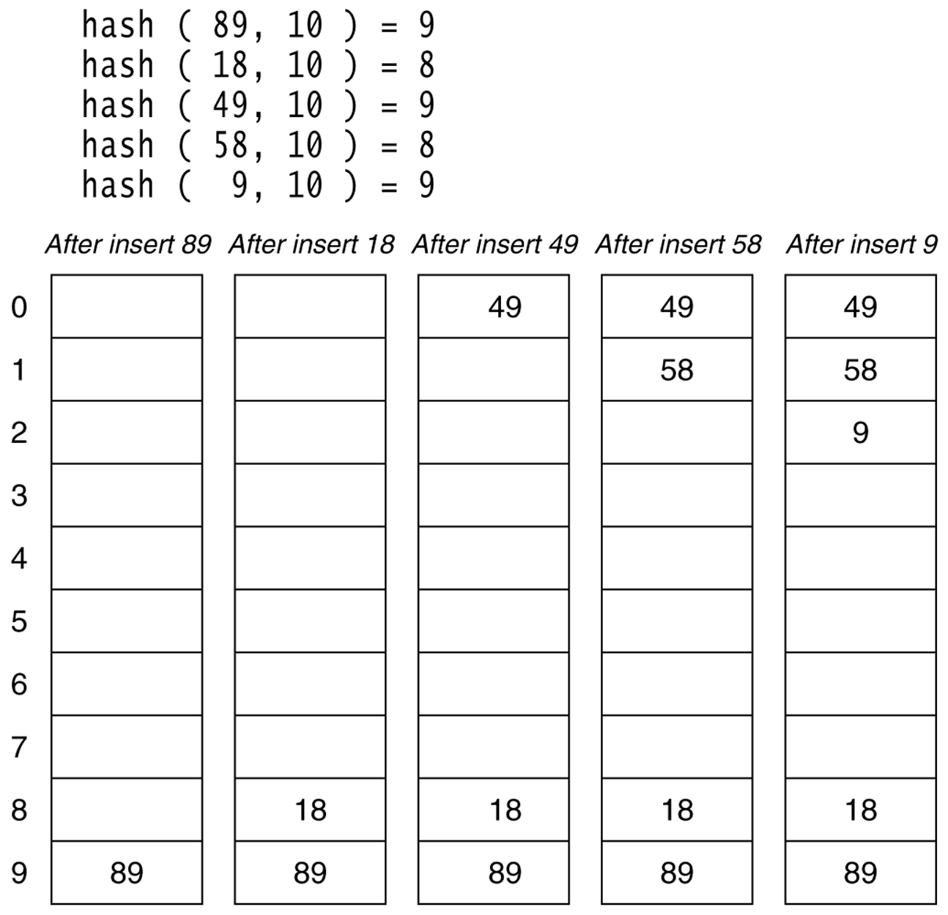
Figure 20.4
Linear probing hash table after each insertion

Slide 15
Quadratic Probing
Quadratic Probing eliminates primary clustering problem of linear probing.
Collision function is quadratic.
The popular choice is f(i) = i².
If the hash function evaluates to h and a search in cell h is inconclusive, we try cells h + 1², h+2², … h + i².
i.e. It examines cells 1,4,9 and so on away from the original probe.
Remember that subsequent probe points are a quadratic number of positions from the original probe point.

Slide 16
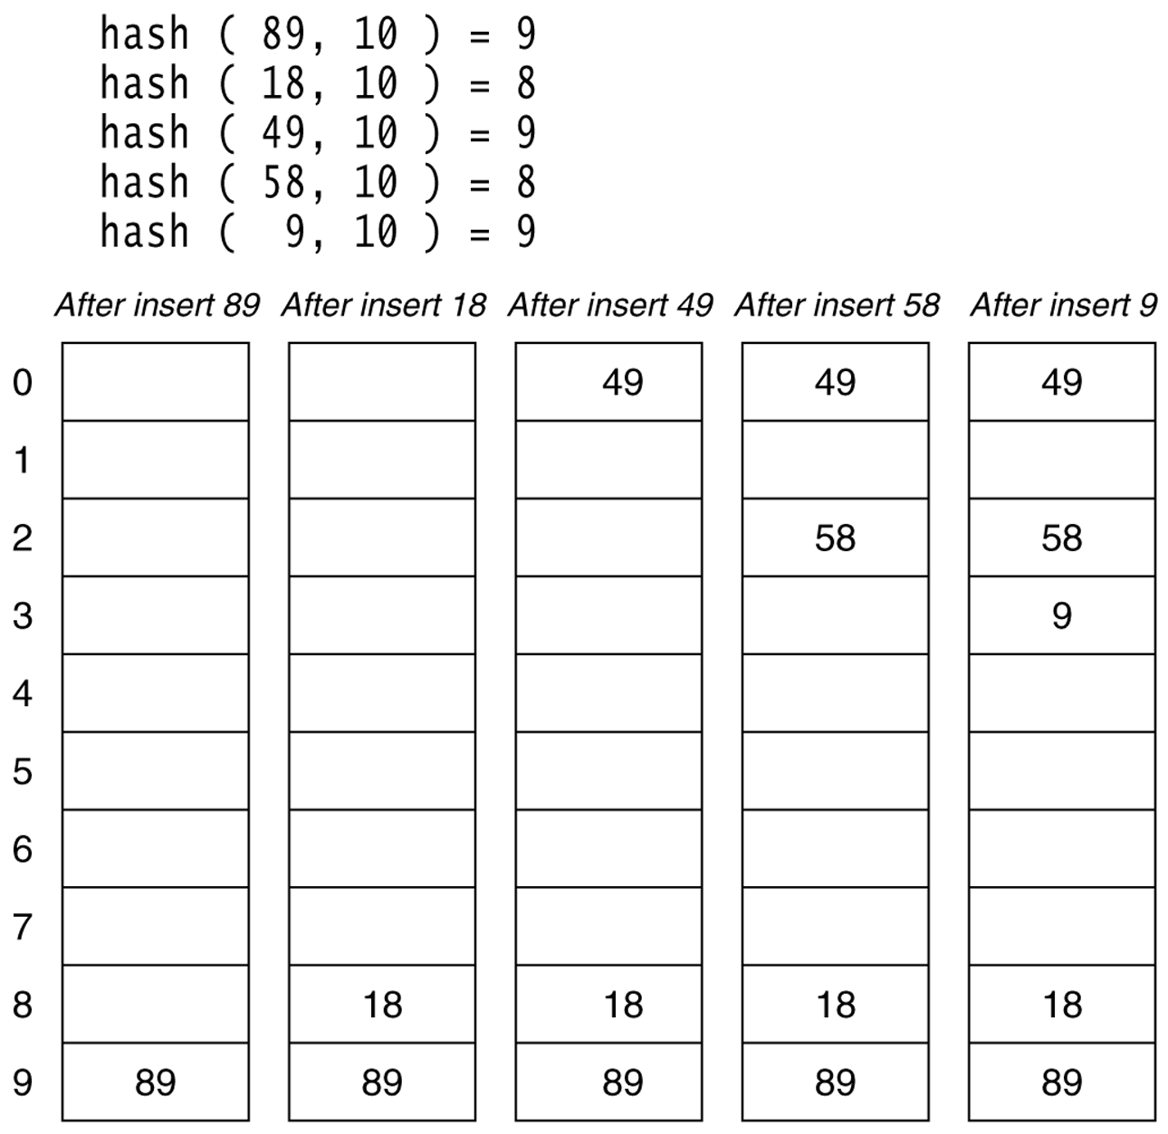
Figure 20.6
A quadratic probing hash table after each insertion (note that the table size was poorly chosen because it is not a prime number).

Slide 17
Hash Indices
Hashing can be used not only for file organization, but also for index-structure creation.
A hash index organizes the search keys, with their associated record pointers, into a hash file structure.
Strictly speaking, hash indices are always secondary indices
if the file itself is organized using hashing, a separate primary hash index on it using the same search-key is unnecessary.
However, we use the term hash index to refer to both secondary index structures and hash organized files.

Slide 18
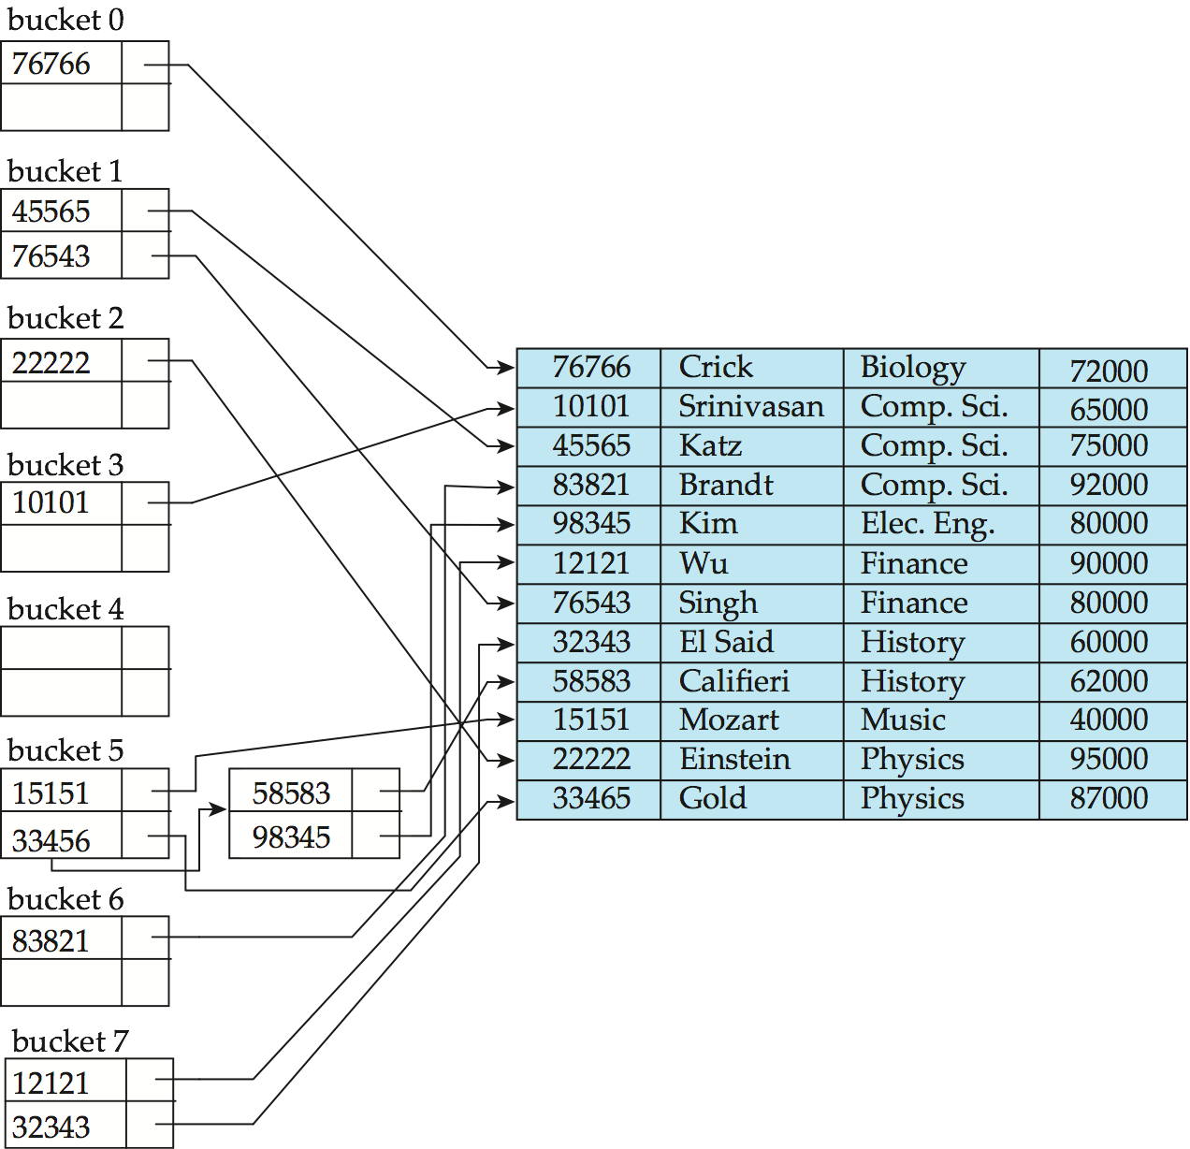
Example of Hash Index
hash index on instructor, on attribute ID

Slide 19
Deficiencies of Static Hashing
In static hashing, function h maps search-key values to a fixed set of B of bucket addresses. Databases grow or shrink with time.
If initial number of buckets is too small, and file grows, performance will degrade due to too much overflows.
If space is allocated for anticipated growth, a significant amount of space will be wasted initially (and buckets will be underfull).
If database shrinks, again space will be wasted.
One solution: periodic re-organization of the file with a new hash function
Expensive, disrupts normal operations
Better solution: allow the number of buckets to be modified dynamically.

Slide 20
Dynamic Hashing
Good for database that grows and shrinks in size
Allows the hash function to be modified dynamically

Slide 21
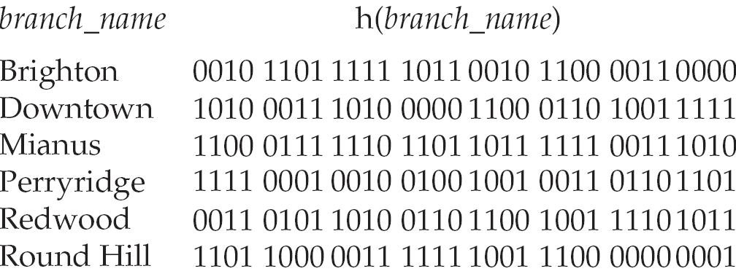
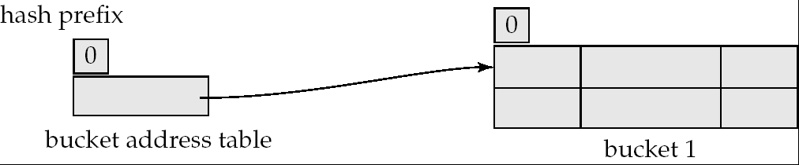
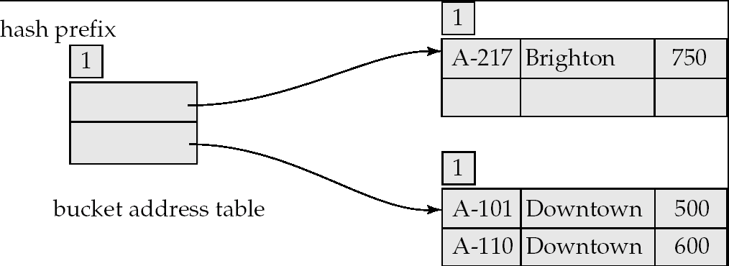
Example of Dynamic Hashing
Insert
Brighton
Downtown
Downtown
Mianus
Perryridge
Perryridge
Perryridge
Round Hill

Slide 22
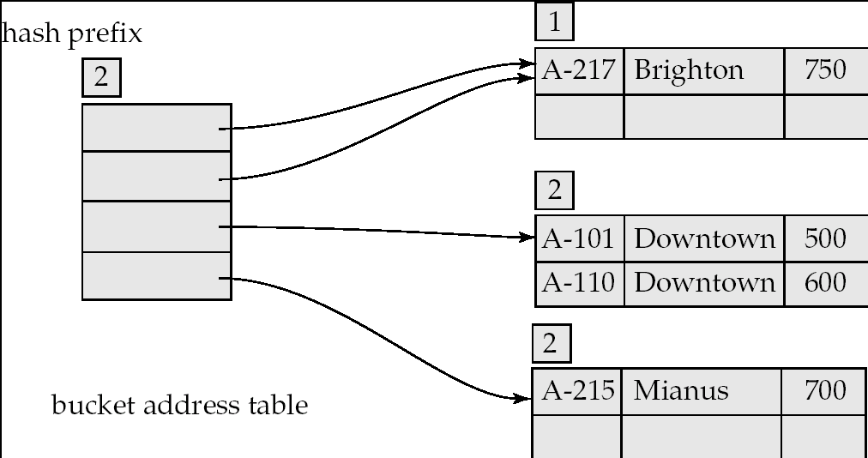
Example of Dynamic Hashing

Slide 23
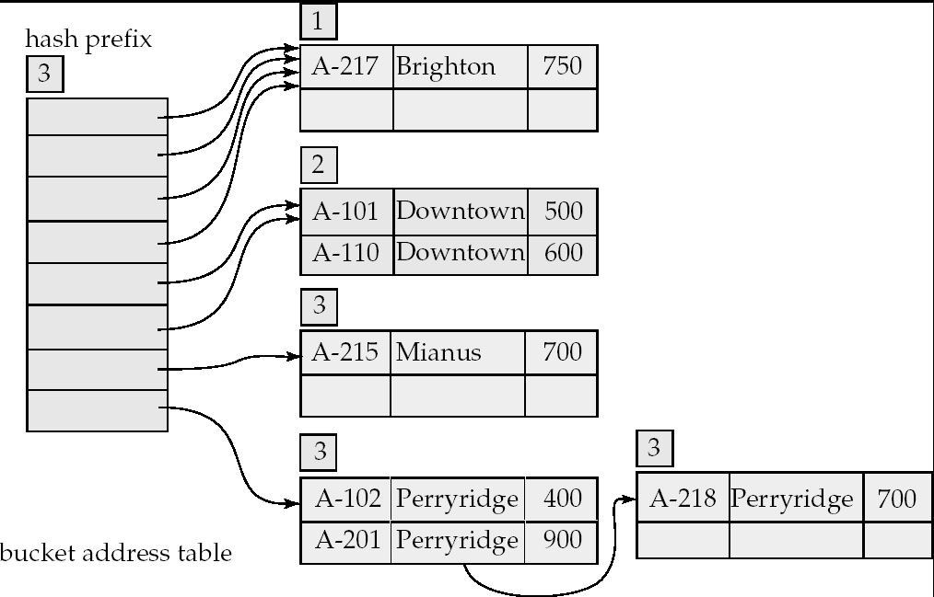
Example of Dynamic Hashing

Slide 24
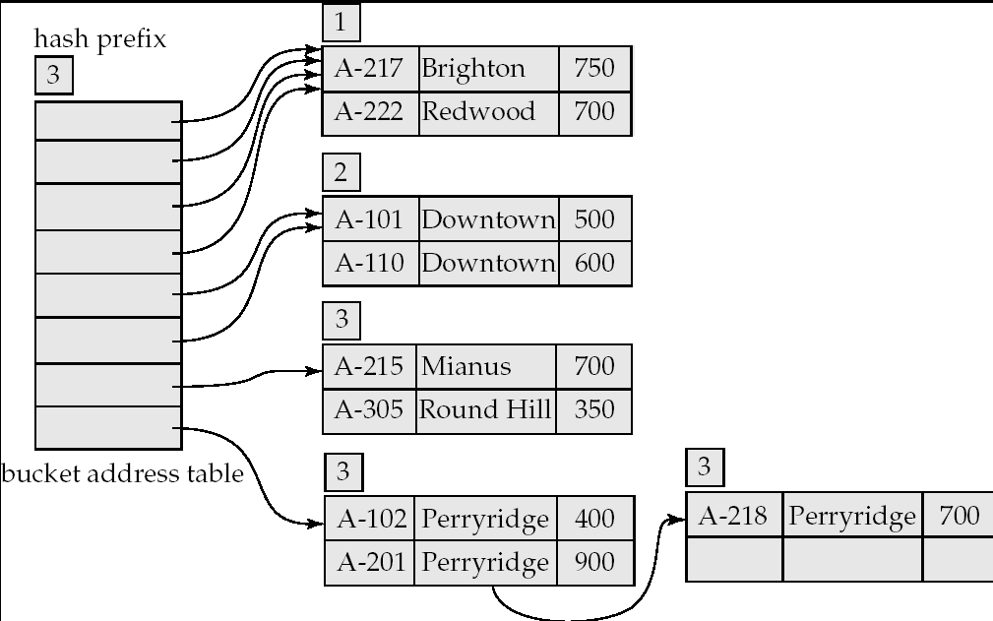
Example of Dynamic Hashing

Slide 25
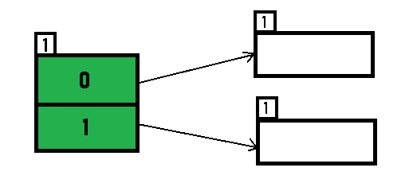
Example based on Extendible Hashing: Now, let us consider a prominent example of hashing the following elements: 16,4,6,22,24,10,31,7,9,20,26. Bucket Size: 3 (Assume) Hash Function: Suppose the global depth is X. Then the Hash Function returns X LSBs.
Solution: First, calculate the binary forms of each of the given numbers. 16- 10000 4- 00100 6- 00110 22- 10110 24- 11000 10- 01010 31- 11111 7- 00111 9- 01001 20- 10100 26- 11010
Initially, the global-depth and local-depth is always 1. Thus, the hashing frame looks like this:

Slide 26
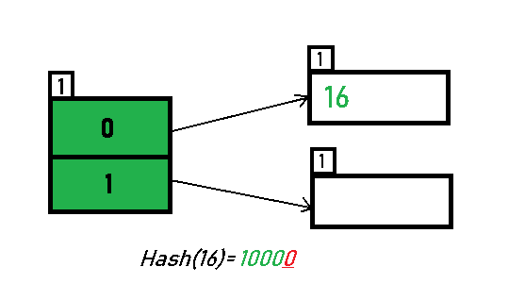
Inserting 16: The binary format of 16 is 10000 and global-depth is 1. The hash function returns 1 LSB of 10000 which is 0. Hence, 16 is mapped to the directory with id=0.

Slide 27
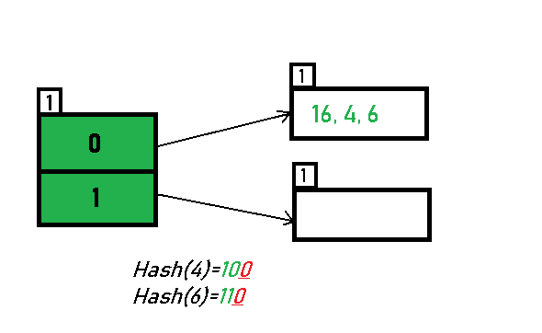
Inserting 4 and 6: Both 4(100) and 6(110)have 0 in their LSB. Hence, they are hashed as follows:

Slide 28
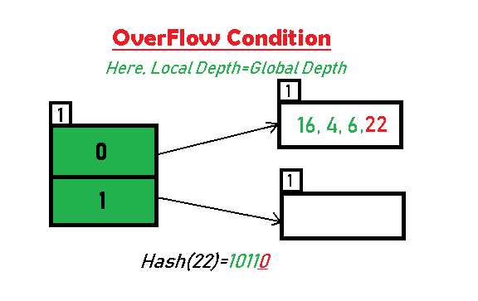
Inserting 22: The binary form of 22 is 10110. Its LSB is 0. The bucket pointed by directory 0 is already full. Hence, Over Flow occurs.

Slide 29
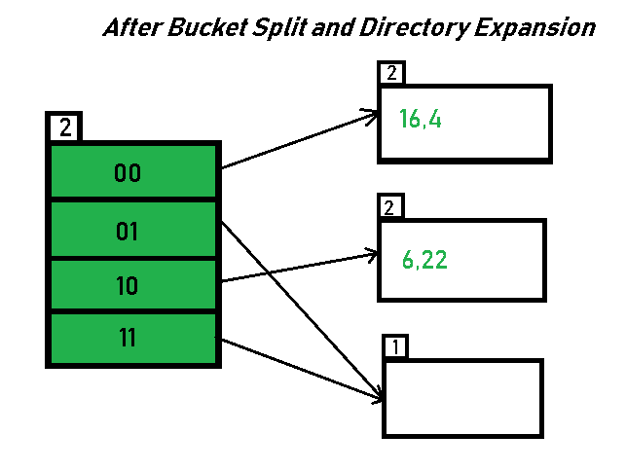
As directed by Step 7-Case 1, Since Local Depth = Global Depth, the bucket splits and directory expansion takes place. Also, rehashing of numbers present in the overflowing bucket takes place after the split. And, since the global depth is incremented by 1, now, the global depth is 2. Hence, 16,4,6,22 are now rehashed w.r.t 2 LSBs.
[ 16(10000),4(100),6(110),22(10110) ]

Slide 30
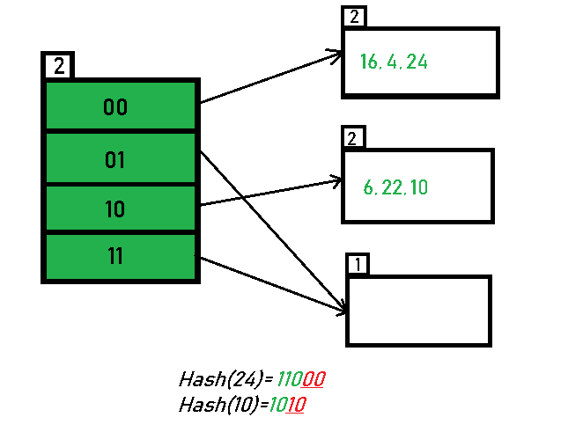
Inserting 24 and 10: 24(11000) and 10 (1010) can be hashed based on directories with id 00 and 10. Here, we encounter no overflow condition.

Slide 31
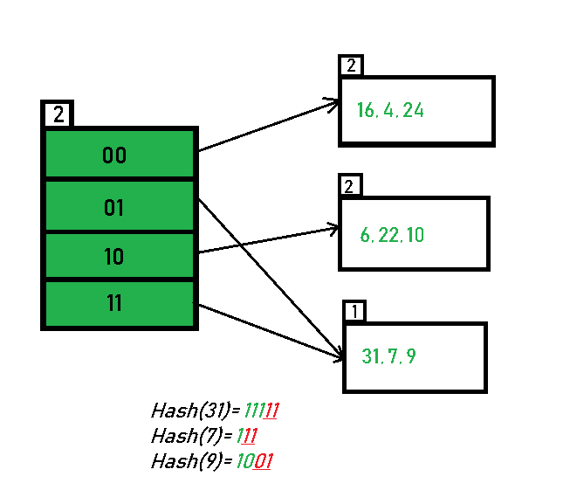
Inserting 31,7,9: All of these elements[ 31(11111), 7(111), 9(1001) ] have either 01 or 11 in their LSBs. Hence, they are mapped on the bucket pointed out by 01 and 11. We do not encounter any overflow condition here.

Slide 32
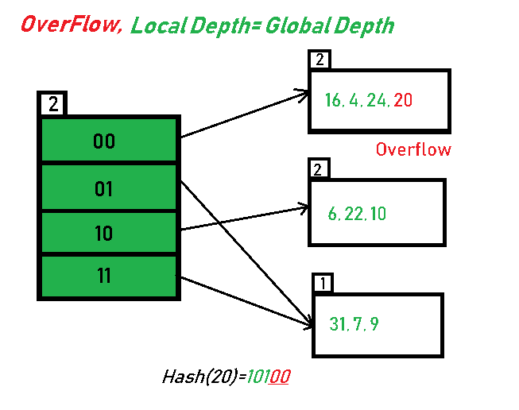
Inserting 20: Insertion of data element 20 (10100) will again cause the overflow problem.

Slide 33
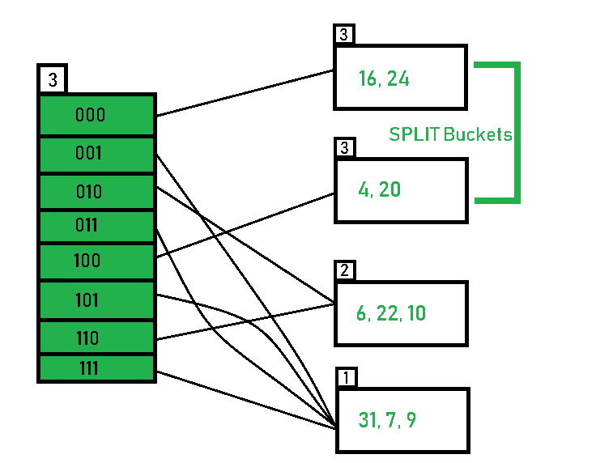
20 is inserted in bucket pointed out by 00. As directed by Step 7-Case 1, since the local depth of the bucket = global-depth, directory expansion (doubling) takes place along with bucket splitting. Elements present in overflowing bucket are rehashed with the new global depth. Now, the new Hash table looks like this:

Slide 34
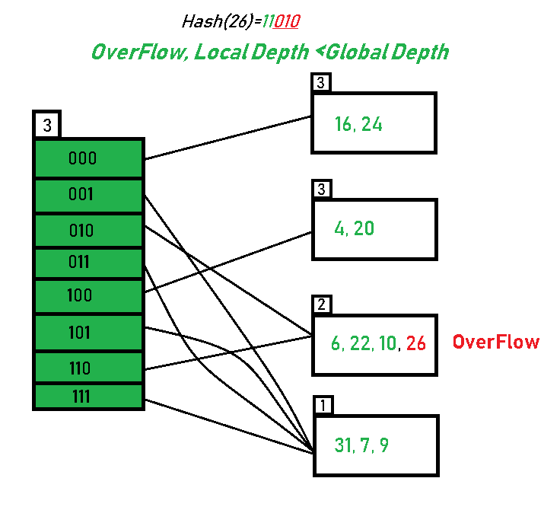
Inserting 26: Global depth is 3. Hence, 3 LSBs of 26(11010) are considered. Therefore 26 best fits in the bucket pointed out by directory 010.

Slide 35
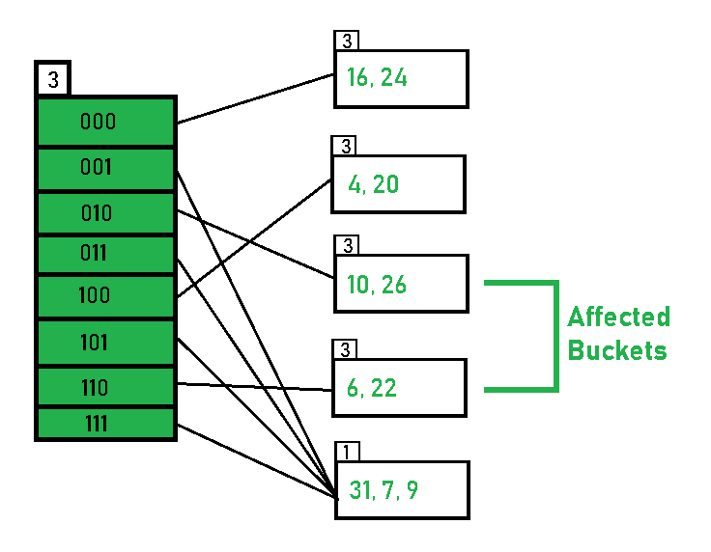
The bucket overflows, and, as directed by Step 7-Case 2, since the local depth of bucket < Global depth (2<3), directories are not doubled but, only the bucket is split and elements are rehashed.
Finally, the output of hashing the given list of numbers is obtained.

Slide 36
Advantages:
Data retrieval is less expensive (in terms of computing).
No problem of Data-loss since the storage capacity increases dynamically.
With dynamic changes in hashing function, associated old values are rehashed w.r.t the new hash function.
Limitations Of Extendible Hashing:
The directory size may increase significantly if several records are hashed on the same directory while keeping the record distribution non-uniform.
Size of every bucket is fixed.
Memory is wasted in pointers when the global depth and local depth difference becomes drastic.
This method is complicated to code.

